Slide 1


Problem Statement ID: 4. Blood and Organ Donor Management
Team Name: The Silent Code
Team Leader Name: Bharath Kanna J
Institute Name: Sri Ramakrishna College of Arts & Science

Slide 2
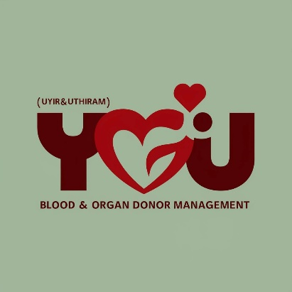


UYIR & UTHIRAM
Flowchart:
Idea/Approach Details
START
In today's world, everyone are seeking for emergency blood and organ donation. The ultimate aim of our Uyir & Uthiram application is to be as a bridge between the hospital / people who seek blood and organ in an emergency situation.
The Flowchart represents the working process of our Uyir & Uthiram in which the user can connect with the donor or even can become as a donor. Each and every donor are verified with proper identity.
Login
Donor & Detail
Receiver Detail
Hospital
Donate Blood
Donate Organ
Blood / Organ Receiver
Who can be a donor
END

Slide 3
Key Features:
Donor Registration: Online registration with detailed medical history, contact information, blood type, organ donor status, and emergency contacts.
Donor Profile Management: Allow donors to update their personal information and medical history.
Eligibility Criteria: Clear guidelines for blood and organ donation eligibility.
Appointment Scheduling: Online appointment booking for blood donation drives and organ donor assessments.
Matching System: Advanced algorithms to match organ donors with recipients based on compatibility.
User-Friendly Interface: Intuitive design for both donors and healthcare professionals.

Slide 4
Use Cases:
Dependencies / Show stopper :
Instant Crisis Communication: Facilitates rapid, reliable, and efficient communication among users in emergency situations.
Community Building and Support: Fosters a strong sense of community by enabling users to connect, share information, and support each other.
Rapid Emergency Response: Enabling fast connection among users in crisis situations.
Medical Records Maintenance: Maintaining patient records and sending it to the relatives of the people.
Once if the connectivity gets lost the application won't work.
Proper installation and maintenance must be done to get a continuous workflow without any delays.

Slide 5

Conclusion:
A comprehensive blood and organ donor management application is essential for streamlining the donation process, optimizing resource allocation, and ultimately saving lives. By incorporating our application with hospital can effectively make changes in the society.
Moreover, by leveraging technology for matching, they contribute to informed decision-making and improved outcomes. Ultimately, a well-designed blood and organ donor management application can serve as a cornerstone for building a strong and resilient healthcare system.

Slide 6
Team Members:
Team Leader Name: Bharath Kanna J
Branch: B.Sc Stream: Computer Science with Data Analytics Year: III
Team Member 1 Name: Aswin S
Branch: B.Sc Stream: Computer Science with Data Analytics Year: III
Team Member 2 Name: Vaisnavi NM
Branch: B.Sc Stream: Computer Science with Data Analytics Year: III

